Slide 1

Analyzing Churn Patterns Among Bank Customers

Slide 2
Team Members
Yougender Chauhan
Suman Chauhan
Nagender Chauhan

Slide 3
Data Description
BankChurners.csv - this file contains basic information about each client (10 columns).
basic_client_info.csv - this file contains some basic client info per each client (6 columns)
.
enriched_churn_data.csv - this file contains some enriched data about each client (7 columns)

Slide 4
Why this Dataset?
The Reason we selected this specific dataset was because it offered us to do SQL, python and Tableau analysis.
This dataset has three different files which allowed us to use the JOIN function in SQL
This dataset also has ample of dimensions and measures for generating some great visuals and insights

Slide 5
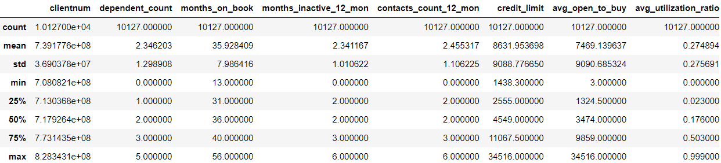
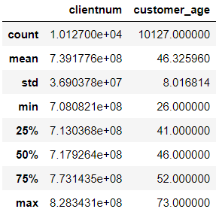
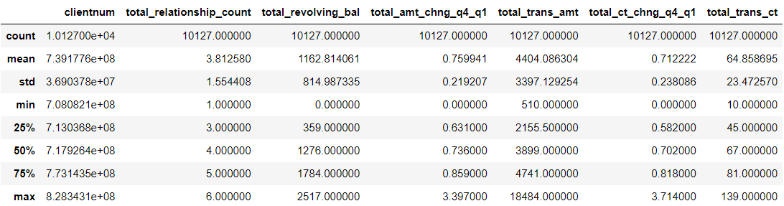
Data Quality and Relevance Summary Statistics
BankChurn.csv
Basic_client_info.csv
EnrichedChurn.csv

Slide 6
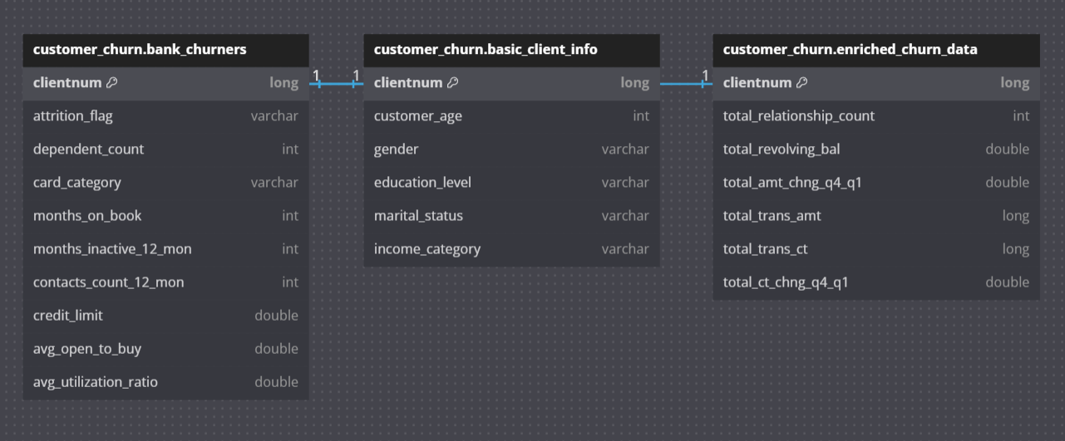
ERD for the Data

Slide 7

Project Summary

Slide 8

Architecture
Data Processing and Analysis
(SQL, Python)
Insights and Future work
Data visualization
(Tableau)
Data Sourcing

Slide 9
Flowchart
Data Sourcing
Data Engineering & Analysis
Download analyzed dataset for visualization
Selecting the relevant Dataset Kaggle.
SQL tasks.
The Tableau task was to tell the story visually by building an interactive Tableau dashboard
Python Analysis.
Data Description.
Data cleaning and summary statistics.

Slide 10
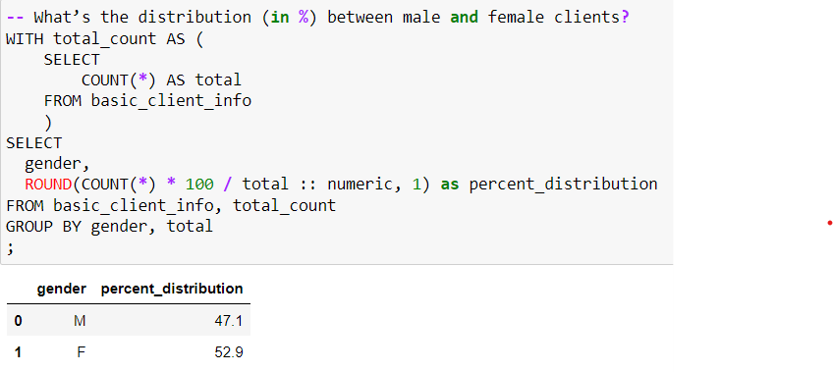
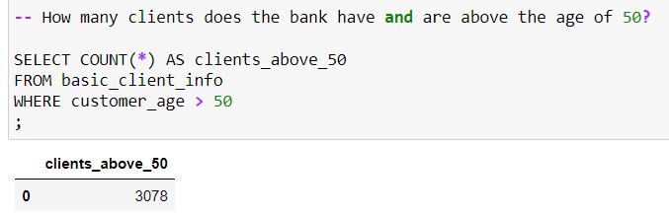
SQL Analysis
1. How many clients does the bank have and are above the age of 50?
2. What’s the distribution (in %) between male and female clients?

Slide 11
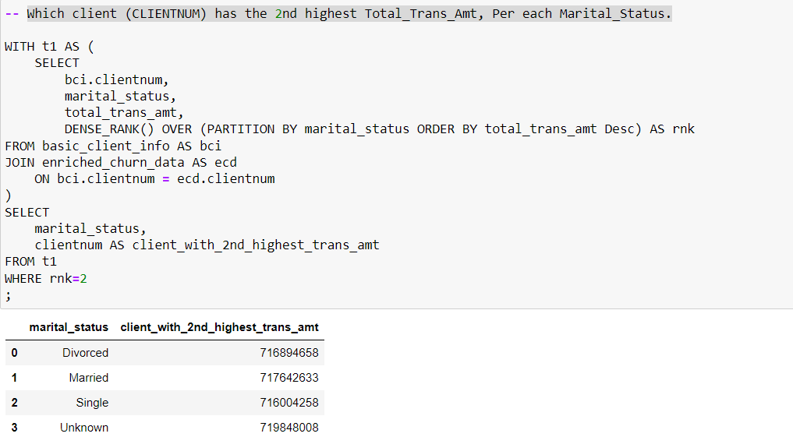
SQL Analysis
3. Which client has the 2nd highest Total_Trans_Amt, Per each Marital_Status.

Slide 12
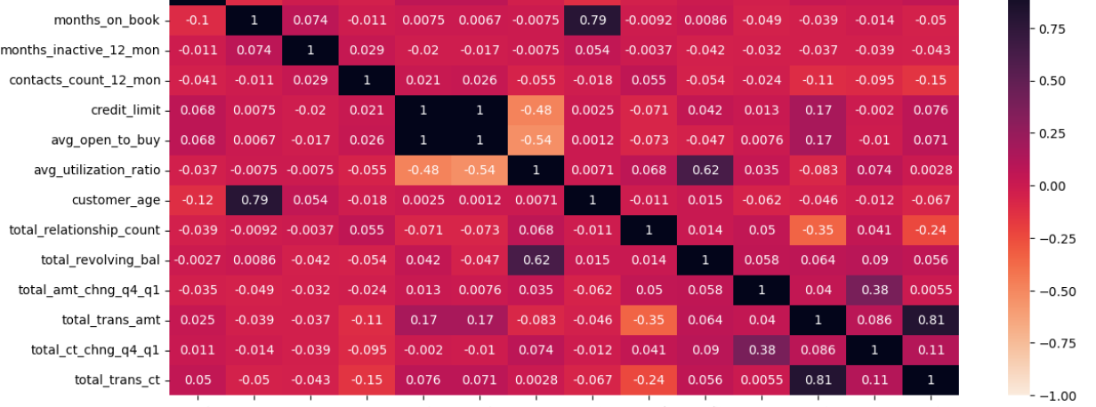
Cross-Correlation Analysis
By cross-examining columns against each other, more insights and broader questions can be asked and answered. let's see how variables are correlated to each other.

Slide 13
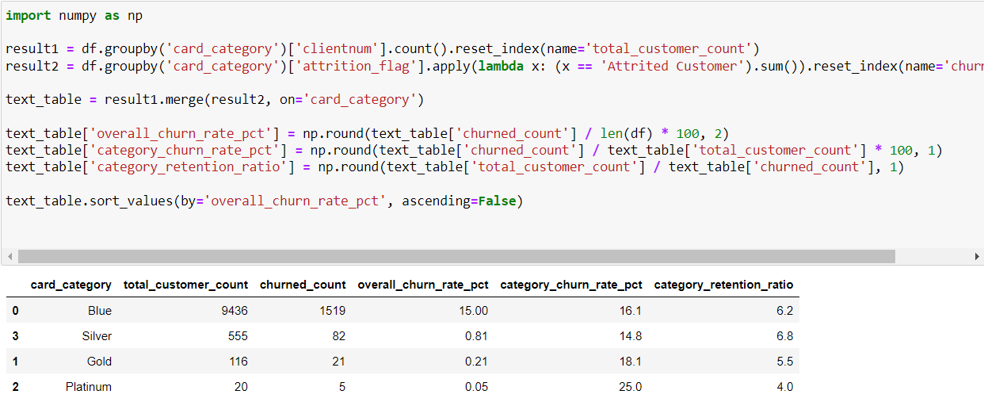
Question 1: What type of credit card holders have churned the most? How about Customer Retention?
The analysis of the bank's credit card churn rates reveals a significant disparity, with blue cardholders exhibiting the highest churn rate at 15%, while Silver, Gold, and Platinum card customers experience rates below 1. The use of category churn rate and retention ratio highlights blue cardholders' higher likelihood of churning, attributed to their larger customer base. A sudden observation that 1 in 4 platinum cardholders churned raises concerns about platinum card customer retention, especially given their small total number of 20 customers. This prompts further investigation into potential factors, such as income categories, influencing customer retention issues in specific card categories.

Slide 14
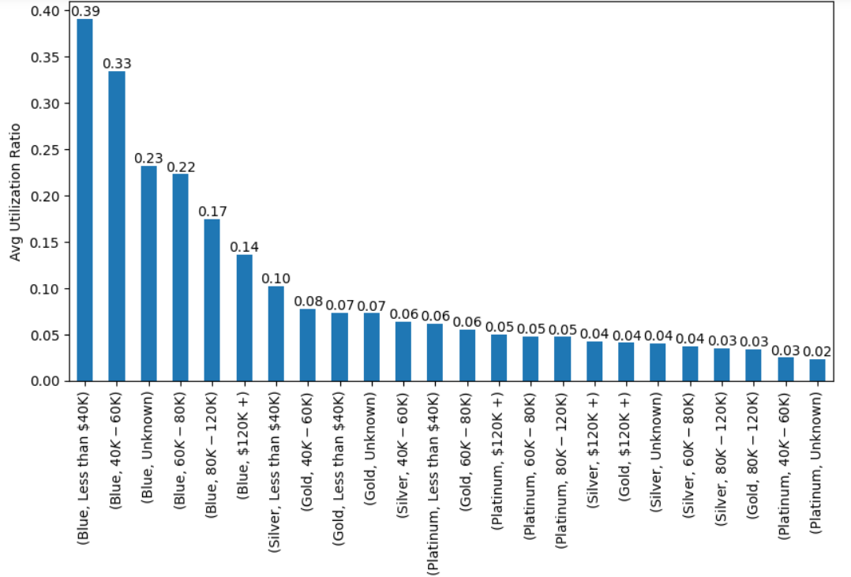
Question 2: Is there a relationship between credit card category, income category and the usage of credit cards by customers?
The plot shows that on average, Blue credit card customers who earn less than $40k and those who earn between 40k-60k tend to use their credit cards the most; while Platinum credit card customers who earn between 40k-60k and those whose income category is unknown, tend to use their credit card the least.
On average, Blue credit card customers of all income categories tend to use their cards way more than Silver, Gold and Platinum credit card customers. And average usage trends amongst Silver, Gold and Platinum credit card customers who earn higher than 60k does not differ much, indicating that these customers are not heavily dependent on their credit cards and might also suggest that they are less likely to be interested in trying out other credit products/services the bank offers.

Slide 15
Tableau Tasks
Demonstration in Tableau

Slide 16
Conclusion
Overall Churn Rate:
Overall churn rate is 16%, implying one in six customers is churning.
A critical metric to monitor for continuous churn mitigation and improved customer retention.
Transaction Amounts:
Average transaction amount for all customers is $4,404.
Churned customers have a significantly lower average transaction amount of $3,095.
Suggests a potential correlation between lower spending and higher churn.
Strategies such as rewards programs or service enhancements could encourage higher transaction amounts.
Customer Spending Behaviors:
Visualizing spending behaviors reveals customers with higher transactions and amounts are less likely to churn.
Customers who churned typically made fewer than 100 transactions and spent less than $5,000 before churning.
Offering incentives for maintaining high activity and transaction levels could be an effective retention strategy.
Customer Churn Demographics:
Average customer age is 46; more female customers than males, majority in the 41-50 age range.
Female clients aged 41-50 exhibit the highest churn rate at 4.4%, compared to 3.3% for males in the same age group.
Overall churn rate higher for females at 9.2% across all age groups, compared to 6.9% for males.
Established customers (25-36 months) have the highest churn rate, particularly for females at 5%.
Marketing and communication efforts can be tailored based on demographic insights to mitigate churn and boost retention.

Slide 17
Limitations and Future Work
Limitations:
Data Scope: The insights are based on existing data, and the analysis may not account for external factors influencing customer behavior, such as economic conditions, industry trends, or competitive actions.
Causation vs. Correlation: While correlations between customer characteristics and churn are identified, the analysis does not establish causation. Additional research is needed to understand the underlying reasons for customer churn.
Dynamic Nature of Customer Behavior: Customer behavior is subject to change over time, and the analysis provides a snapshot. Continuous monitoring is essential to adapt strategies based on evolving customer preferences and external influences.
Future Work:
Qualitative Research: Conducting qualitative research, such as customer interviews or surveys, can provide deeper insights into customer motivations and preferences, enhancing the understanding of factors influencing churn.
Predictive Analytics: Developing predictive models using machine learning techniques can forecast potential churn, enabling proactive measures to retain customers before they exhibit churn behavior.
Longitudinal Analysis: Analyzing customer behavior trends over an extended period could reveal patterns or seasonal variations that impact churn, allowing for more nuanced and strategic interventions.
Cost-Benefit Analysis: Evaluating the cost-effectiveness of proposed retention strategies, considering potential returns on investment, can guide the bank in prioritizing and implementing the most impactful initiatives.

Slide 18

Any Questions?

Slide 19


